Slide 1
MACHINE TRANSLATION OF LITERARY TEXTS
A comparative study on the translation of two different literary genres by three neural machine translation systems
Ana Isabel Cespedosa Vázquez
Ruslan Mitkov

Slide 2
01. Rationale
02. Aim
03. Methodology
04. Results and discussion
05. Limitations
06. Conclusion
OUTLINE

Slide 3
01
Rationale

Slide 4
01 Rationale
PRESENT
RESEARCH
Recent advances in Artificial Intelligence and MT
Neural MT systems implementation
Negative perception when applied to literary texts
Lack of studies on literary MT

Slide 5
02
Aim

Slide 6
02 Aims
Compare the performance of 3 recent NMT systems on literary texts
Identify whether MT performance is influenced by genre and time period

Slide 7
03
Methodology

Slide 8
03 Methodology
a. Dataset: texts and translations
b. Selection of Neural Machine Translation systems:
→ DeepL
→ Systran
→ Yandex
Pride and prejudice (Jane Austen)
1984 (George Orwell)
I Felt a Funeral, in my Brain (Emily Dickinson)
Siren Song (Margaret Atwood)

Slide 9
03 Methodology
c. BLEU metric implementation:
Installing Python Downloading necessary complements: → NLTK library → Corpus function | Creating the code to be run in Python Defining the required commands
Image: Excerpt from the code

Slide 10
04
Results and discussion

Slide 11
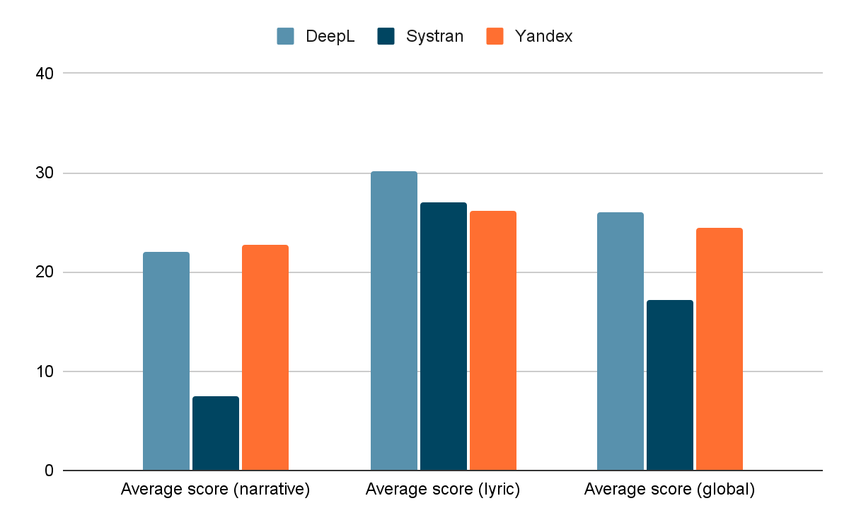
BLEU results
DeepL had the best performance
The MT systems had a better performance for lyric rather than narrative genre
Average score for each genre and global score for each MT system.

Slide 12
BLEU results
Work | 1984 | Pride and prejudice | I Felt a Funeral, in my Brain | Siren Song
Average score (for 3 MT systems) | 22.08 | 19.13 | 17.16 | 38.37
Average score according to the time of the work for each MT system.

Slide 13
BLEU results
 | DeepL | Systran | Yandex
Average score for classical literature | 15.07 | 14.55 | 15.25
Average score for contemporary literature | 37.05 | 19.91 | 33.72
Average score according to the time of the work for each MT system.

Slide 14
05
Limitations

Slide 15
Limitations of the study
BLEU LIMITATIONS
The system compares between MT and HT rather than analysing context or meaning
DATA SIZE
Insufficiently number of texts (only four have been used)
CORPUS REPRESENTATIVENESS
A greater range of linguistic features should be taken into consideration

Slide 16
06
Conclusion

Slide 17
Conclusion
According to BLEU:
The MT system Deepl had the best performance
Further research on MT applied to literary texts should be carried out
Genre and time are related (and should be taken into consideration) when translating a text

Slide 18
It is not the nature of translation technology itself that should be criticized but the discourse surrounding it and the lack of inclusion of all interested parties in the innovation process.
Paola Ruffo

Slide 19
Thank you very much for your time and attention!
Ana Isabel Cespedosa Vázquez
anabelcespedosa@gmail.com
Ruslan Mitkov
r.mitkov@lancaster.ac.uk

